Slide 1
Hot Topics: Side Channel Attacks CS-4440 - Introduction to Computer Security Spring 2022 Jun Xu Slides adapted from COSIC 2015 by Josep Balasch and from Robert Brotzman-Smith at Penn State

Slide 2
Scheduling Plans
Today: Side Channel Attacks
Wednesday (April 20th): Final Exam Review
Monday (April 25th): I need to attend a conference at San Diego, so no class (sorry)

Slide 3
Course Feedback
Course Feedback surveys are open for this course
Please help take several minutes to complete the surveys
Your feedback is critical to help improve this course in the future
If you do not like something in this course or about me, you should let me know so I can improve
If you like something in this course or about me, please let the school know (so that they will continue allowing me to teach this course -:)
I will give 0.5 point as a bonus if the response rate is over 60% (sorry I cannot be too generous)

Slide 4
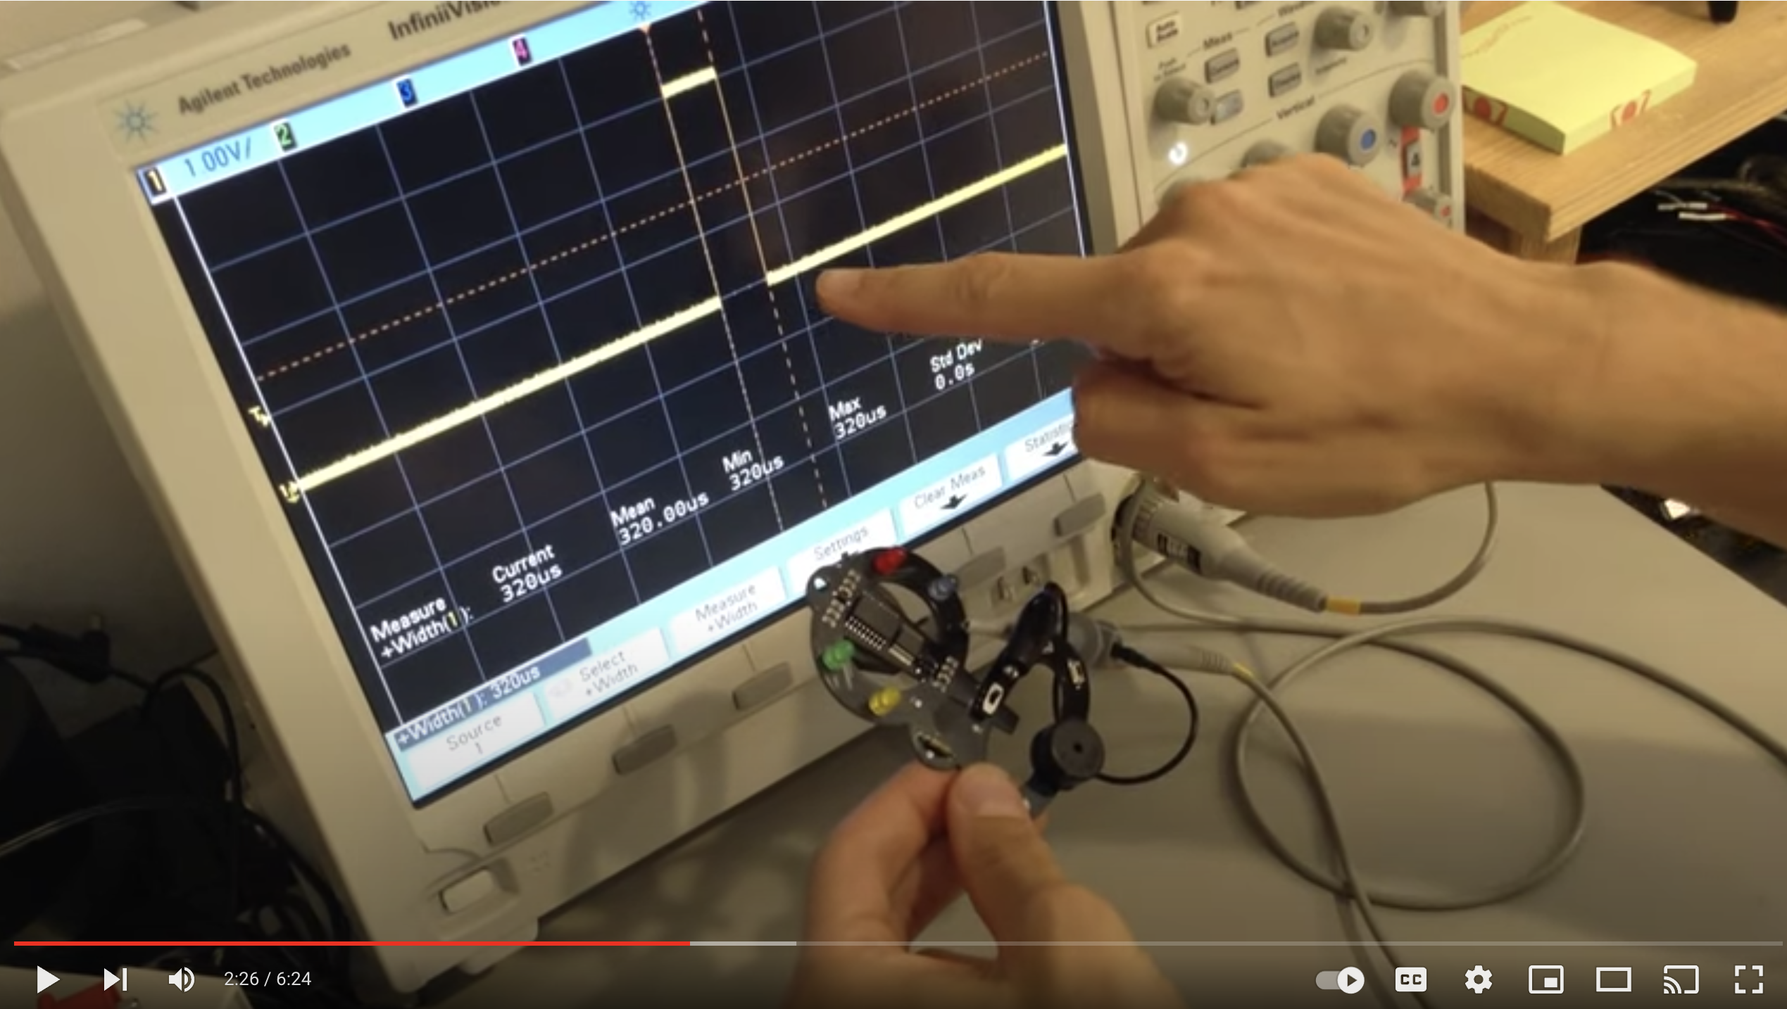
Side Channel Attacks: Let’s get a bit of sense
https://www.youtube.com/watch?v=2-zQp26nbY8&ab_channel=JoeGrand

Slide 5
Definition of Side Channel Attacks
In computer security, a side-channel attack is any attack based on information gained from the implementation of a computer system, rather than weaknesses in the implemented algorithm itself (e.g., software bugs). Timing information, power consumption, electromagnetic leaks or even sound can provide an extra source of information, which can be exploited.
No Vulnerability Is Needed!
No Theoretical Weaknesses of Algorithms Are Needed!
https://en.wikipedia.org/wiki/Side-channel_attack

Slide 6
Common Categories of Side Channel Attacks
Timing Side Channel

Slide 7
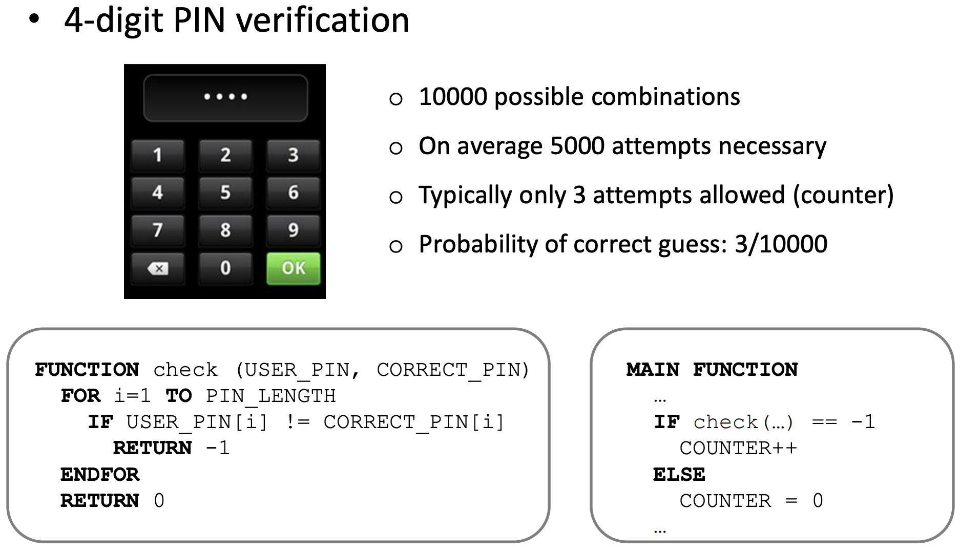
Timing Side Channel: Example 1

Slide 8
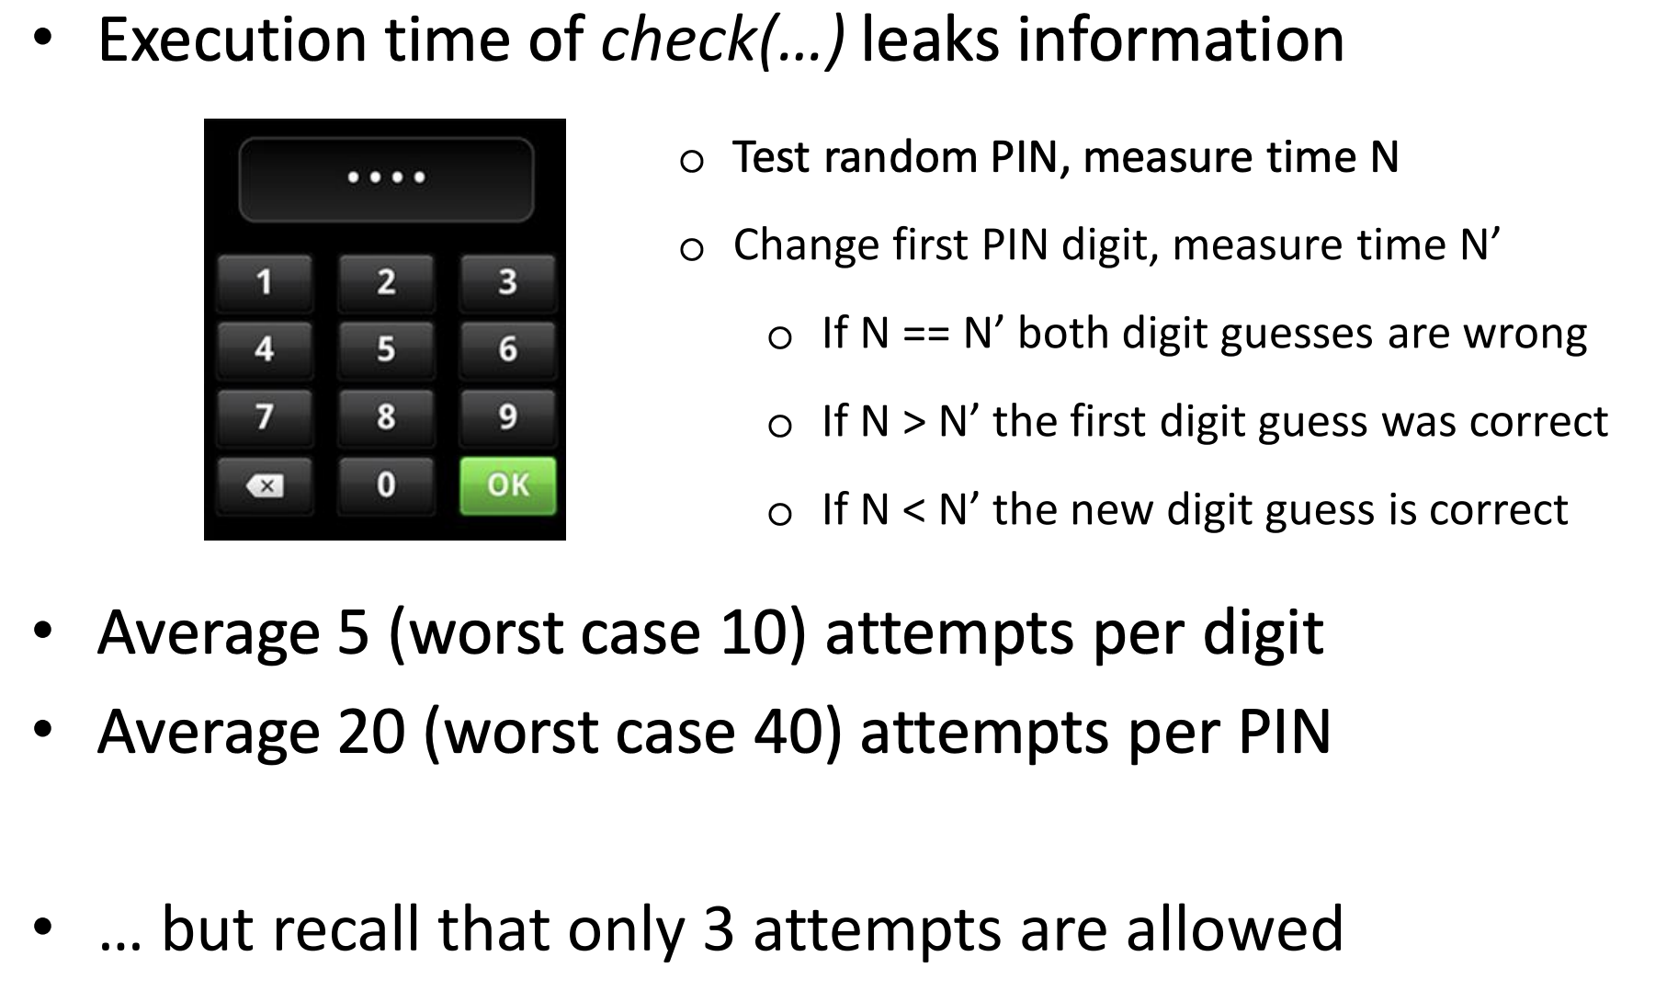
Timing Side Channel: Example 1

Slide 9


What About Timing Side Channel on Your Password?
Byte 1 of JX password
Time 1

Slide 10
Mitigate Timing Side Channel against User Password?
Never transfer the password in plan text, using hash instead
Use operations that incur constant CPU execution time (e.g., Bitwise operations: x & y, x | y, x ^ y, ~x)
You could inject random noise into your logic, in the hope that it will confuse the attacker‘s measurements (e.g., make sure every password checking, correct or wrong, uses the same amount of time)
…
https://security.stackexchange.com/questions/220446/how-can-i-prevent-side-channel-attacks-against-authentication

Slide 11
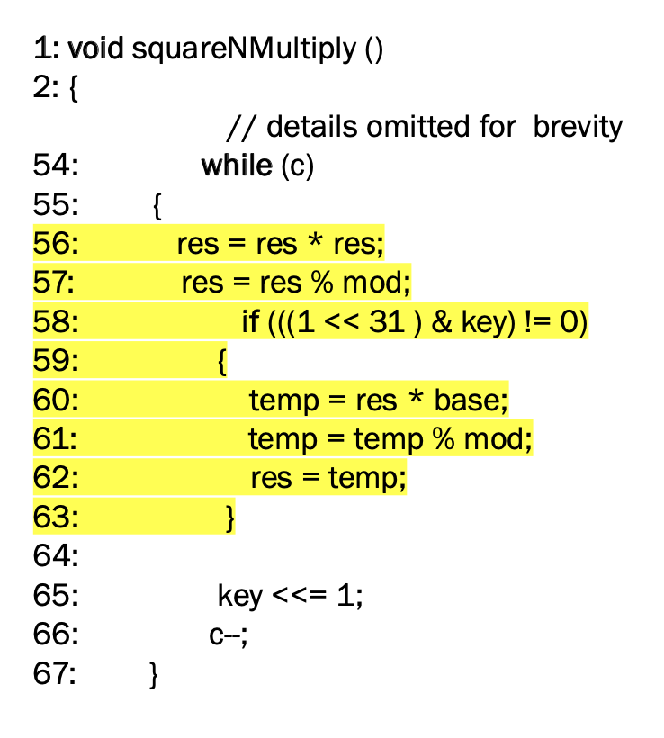
Timing Side Channel: Example 2
Example is from libgcrypt which is a common cryptographic library
Modular exponentiation
Commonly used in RSA
Assuming “key” is the private key
What can go wrong here?

Slide 12
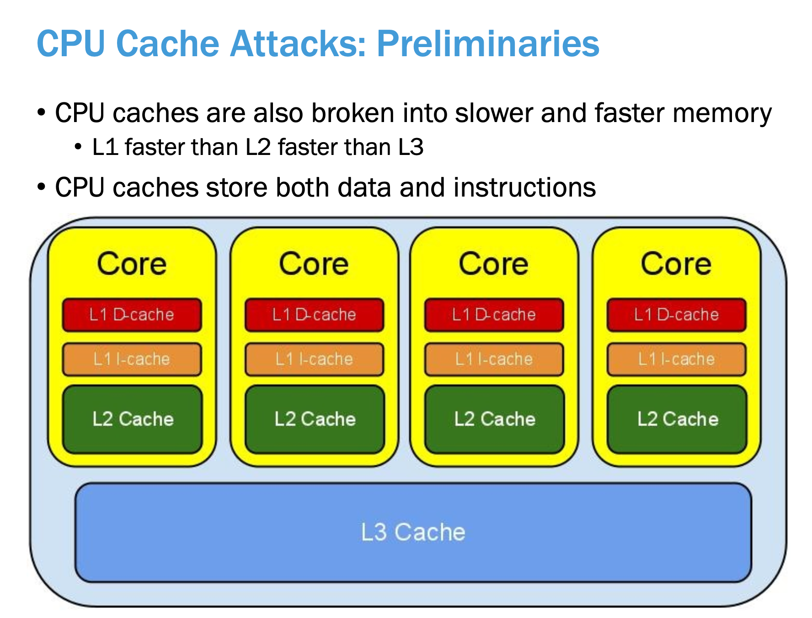
Timing Side Channel: Example 3

Slide 13
Timing Side Channel: Example 3
Modern CPU caches are typically N-way set associative
Opposed to being directly mapped or fully associative
In N-way set associative caches, there are cache size/N sets
E.g., 32 kb 8-way cache will have ~4000 cache sets
Memory can be mapped to one cache set and the processor will apply a replacement policy to each cache set
E.g., least recently used, pseudo least recently used, not most recently used
The replacement policy is typically what allows adversaries to learn information through a side channel
This is because most commercial processors use a replacement policy that is related to recent program behavior

Slide 14
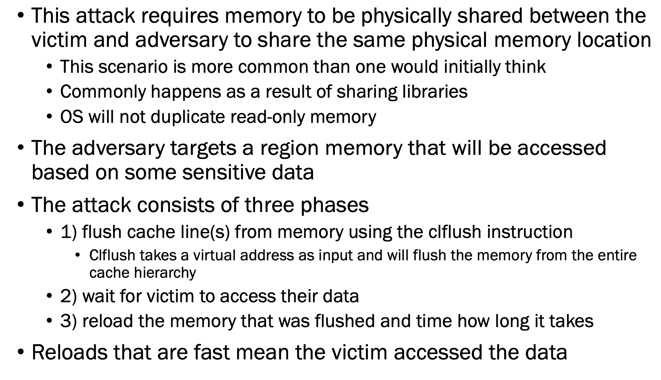
Flush+Reload

Slide 15
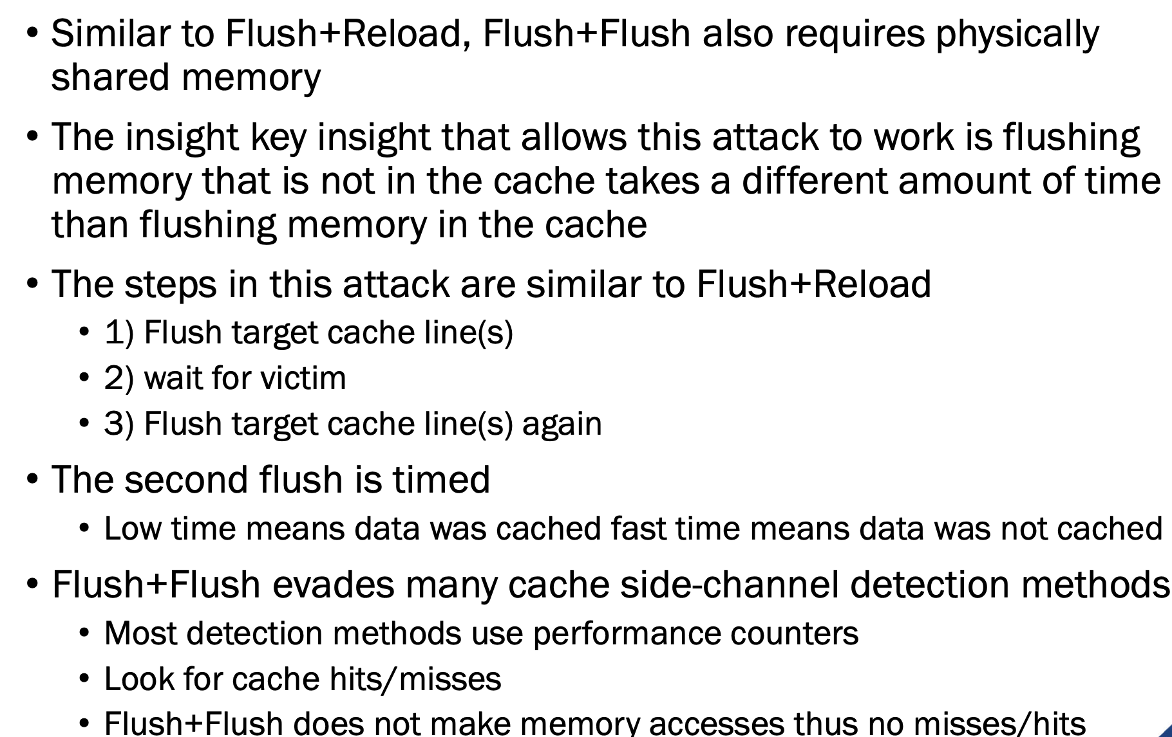
Flush+Flush

Slide 16
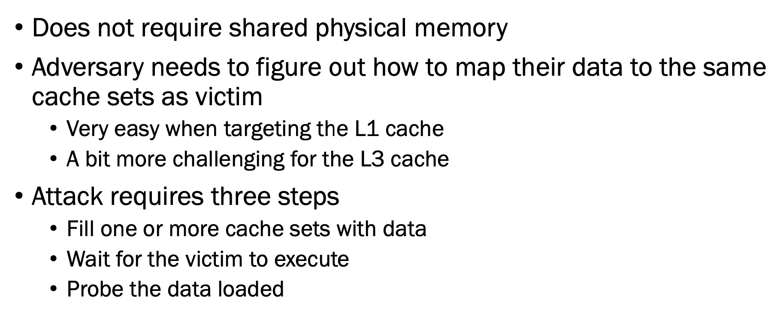
Prime+Probe

Slide 17
Let’s see an example
https://youtu.be/DkWqLDSqHm8?t=1053

Slide 18
Timing Side Channel: Example 4
Out-of-Order & Speculative Execution
Out-of-order execution happens anytime another instruction is executed before previous instruction(s) are retired
Speculative execution happens when the result of a branch is unknown and execution proceeds down a guessed branch
Both of these optimizations help to maximize the CPU resources
Transient Instructions
Any instruction which can be executed out of order and leaves measurable side effects
E.g., memory loads/stores

Slide 19
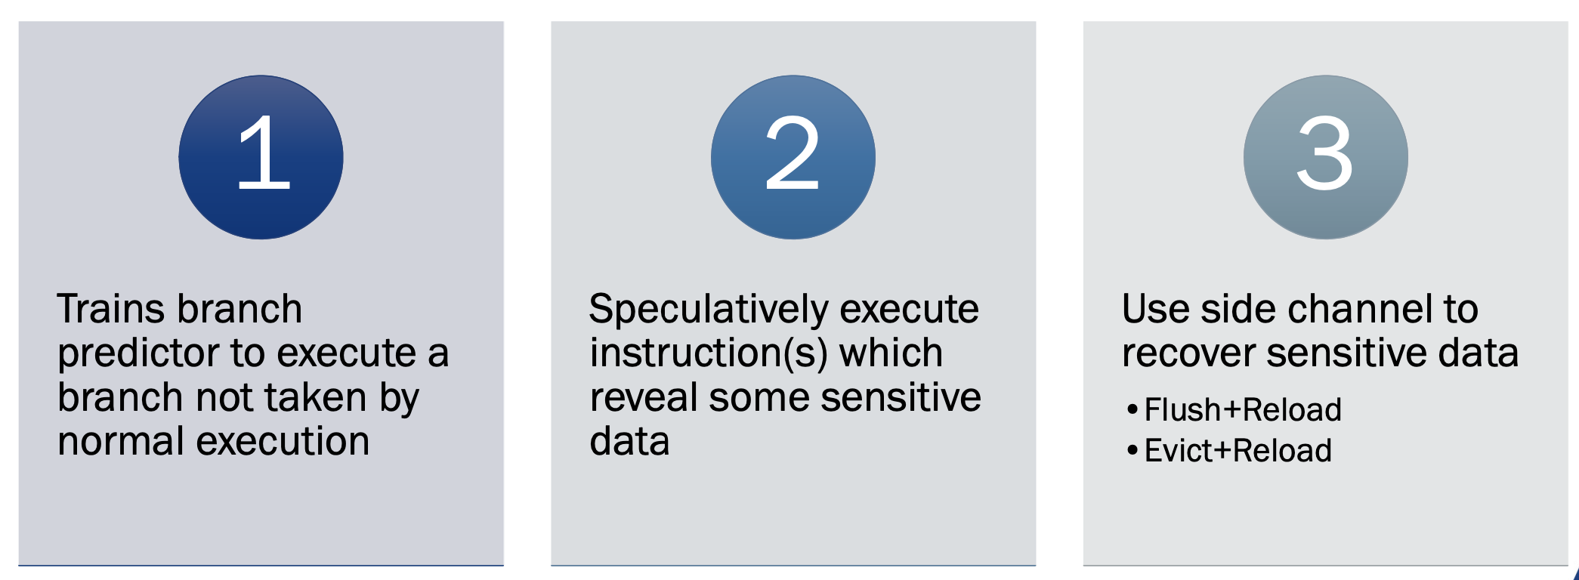
Timing Side Channel: Example 4: Spectre Attack

Slide 20
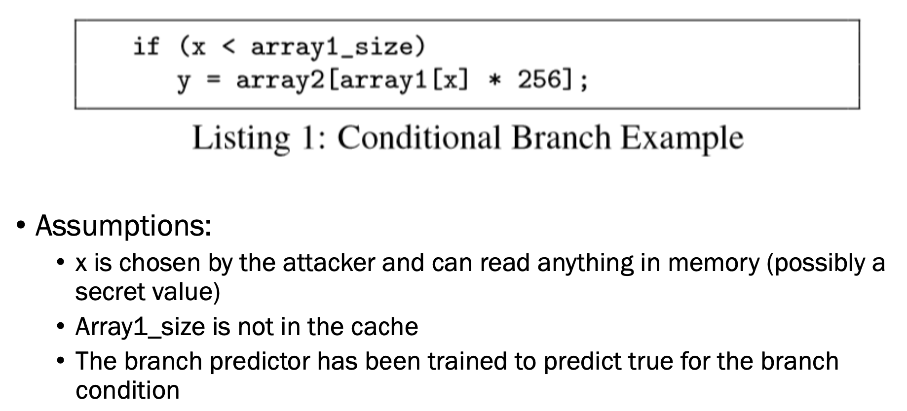
Spectre Exploiting Conditional Branches

Slide 21
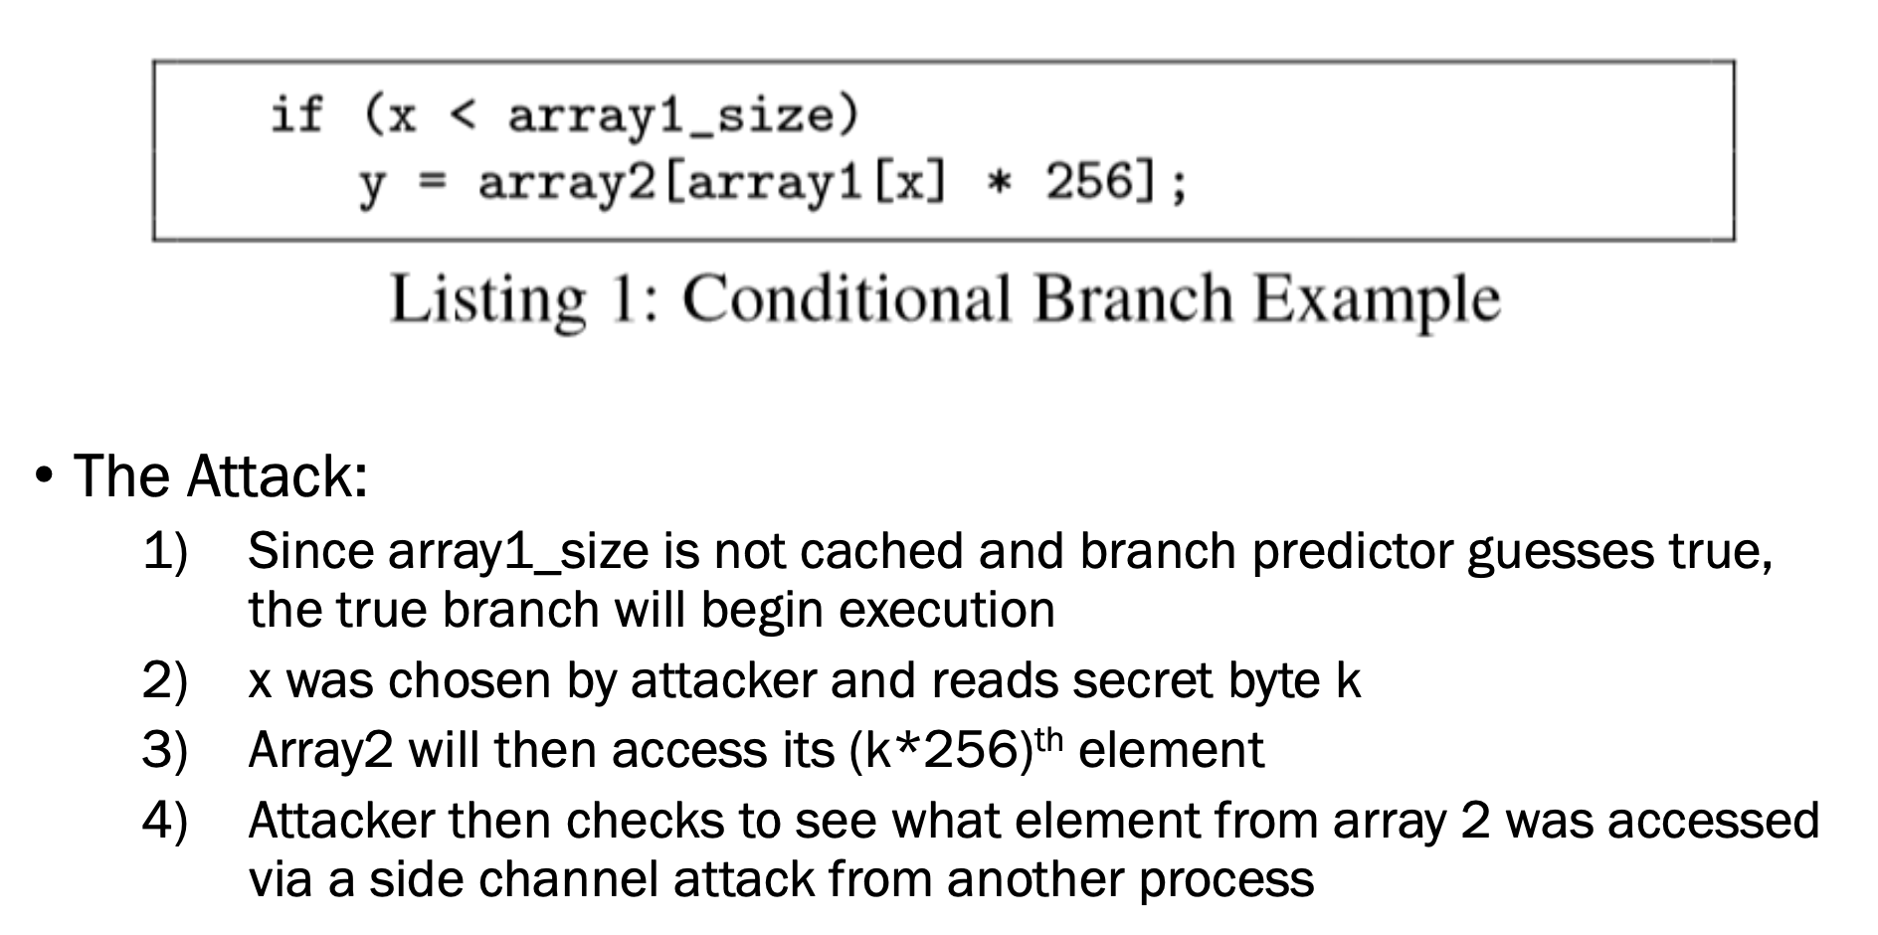
Spectre Exploiting Conditional Branches

Slide 22
Common Categories of Side Channel Attacks
Power Analysis

Slide 23
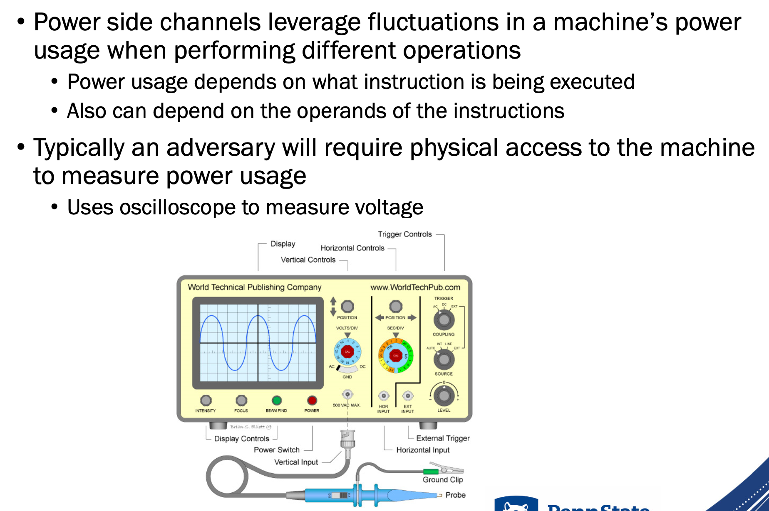
Power Analysis Side Channel Attack
https://www.youtube.com/watch?v=FktI4qSjzaE&list=PLhixgUqwRTjwNaT40TqIIagv3b4_bfB7M&index=13&ab_channel=LiveOverflow

Slide 24
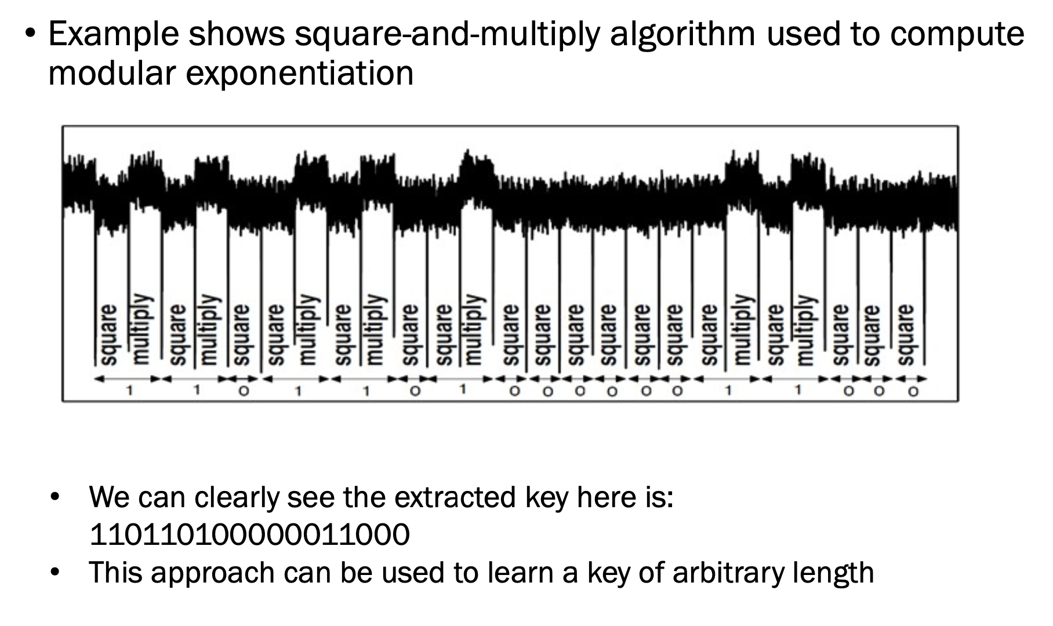
Simple Power Analysis
https://www.youtube.com/watch?v=bFfyROX7V0s&ab_channel=LiveOverflow

Slide 25
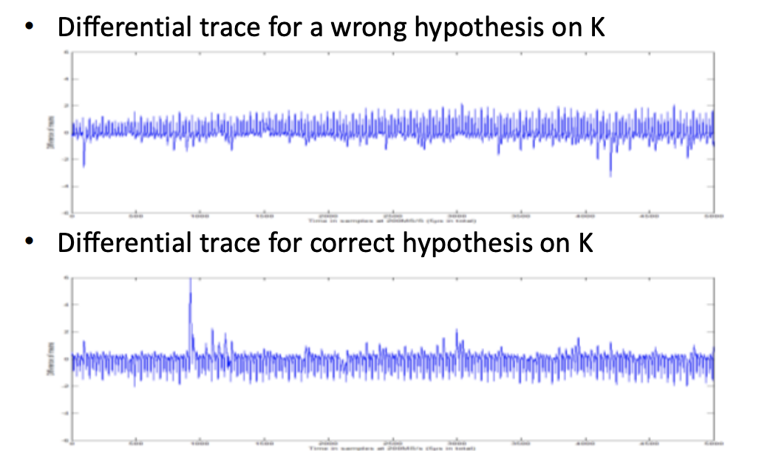
Differential Power Analysis
• Differential attacks use statistics to exploit the data-dependent variations of the power consumption
https://www.youtube.com/watch?v=FktI4qSjzaE&list=PLhixgUqwRTjwNaT40TqIIagv3b4_bfB7M&index=14&ab_channel=LiveOverflow

